Slide 1

What is SEO?
Image from http://blaugh.lockergnome.com/
CS/IT 490 WD, Fall 2013

Slide 2
What is SEO?
SEO is “Search Engine Optimization”
Techniques to make Google (or, uh, Bing and Yahoo?) <3 your webpage
Google doesn't tell you explicitly how its listing algorithm works
  Mix between good practices and people with magical tomes of speculation on what would be good to do.

Slide 3
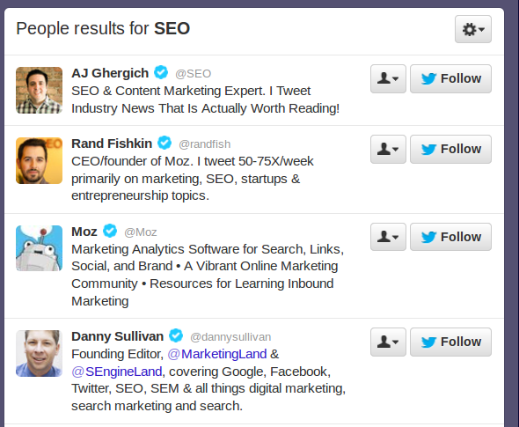
What is SEO?
Eww, marketing

Slide 4
What is SEO?
But sometimes you want to be found online.
Let's say you're posting your own movies to YouTube. You won't get discovered without:
  A description
  Tags
But lots of people leave this stuff off!

Slide 5
What is SEO?
Customers who need/run a website care about
  Analytics (Who is visiting what pages, when, where do they come from? Click tracking, heat maps)
  SEO (Is my company's website likely to show up when you do a search for “Sporting goods for kittens”? And on what page?)
  PPC – Pay-per click – Paying Google for space on the front page of a search

Slide 6
What is SEO?
Customers who need/run a website care about
  “Link juice” - Links from credible websites supposedly help your website do better (but don't try to generate these artificially or you might get black-listed!)

Slide 7
What is bad?
If you follow shady practices to try to get better placement in search results, Google will blacklist you!
  Generating phony links to your page
  Content hiding (e.x. Once on the page, Javascript generates your Viagra adverts that don't show up in the HTML)
  Duplicate content
  Linking to spam sites
  Link schemes

Slide 8
SEO
As we cover content in this class, I will try to highlight relevant SEO tips.
If you're interested in learning more, check out an SEO book from a library, or read up on blogs.

Slide 9
References
-

